Slide 1
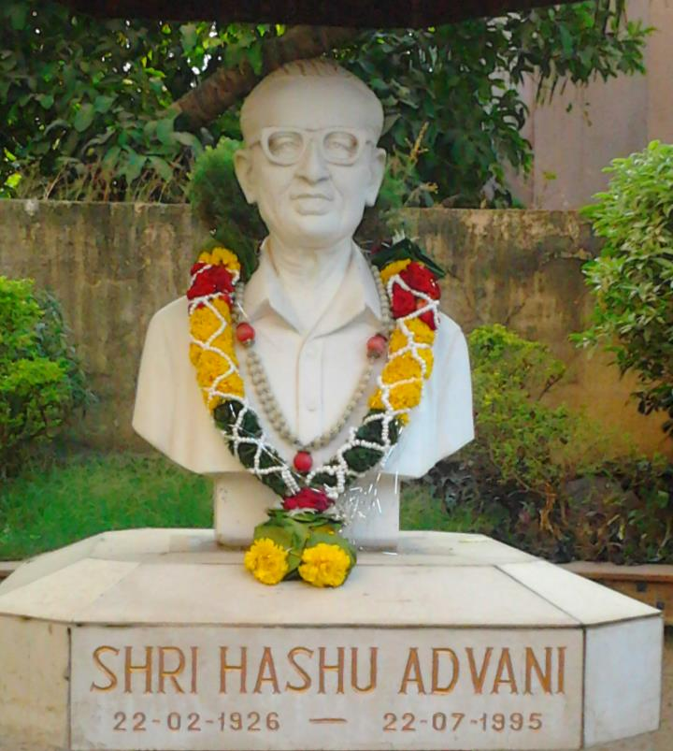
CHEMBUR COLONY YUVAK MANDAL’S
HASHU ADVANI COLLEGE OF SPECIAL EDUCATION

Slide 2
HACSE: We create attitudes….

Slide 3
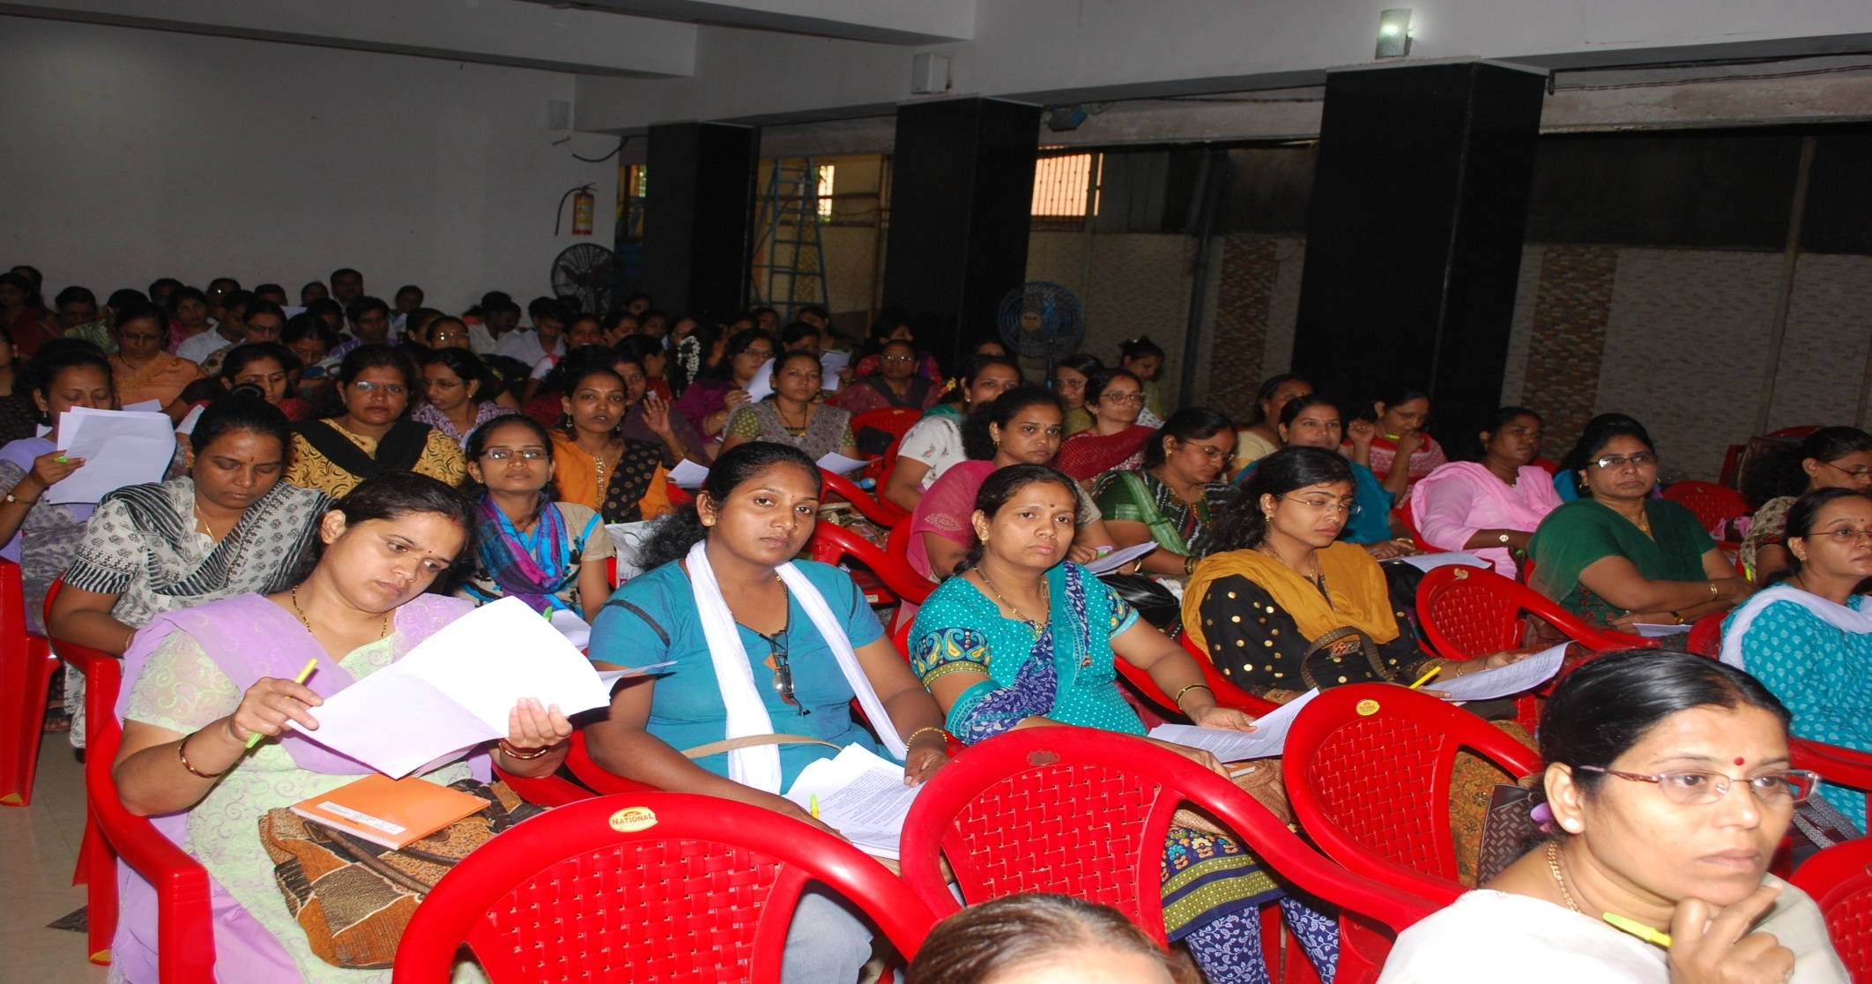
HACSE: we create opportunities…

Slide 4
HACSE: we create teams…

Slide 5
HACSE: We create answers….

Slide 6
HACSE: we create collaborations…

Slide 7
HACSE: we create citizens….

Slide 8
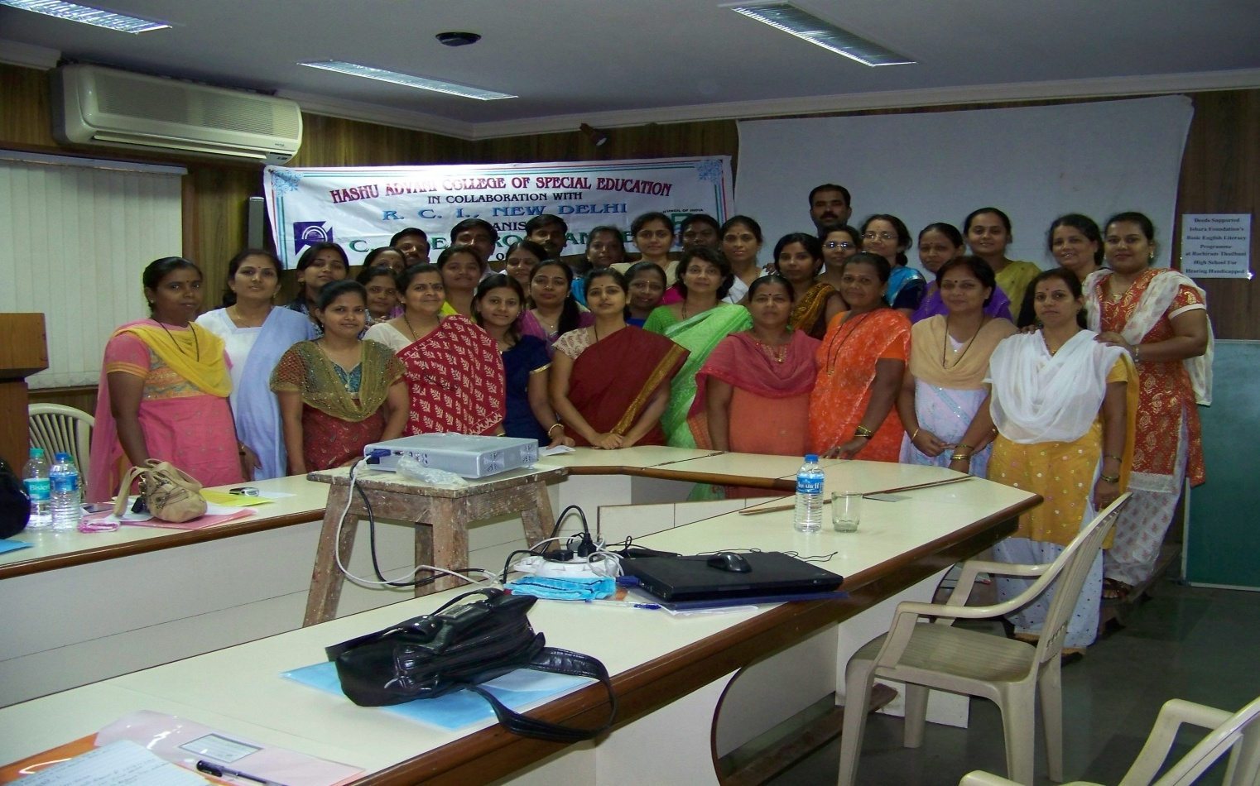
HACSE: www.hacse.org.in
Yes, we also create teachers…..

